Slide 1
Super Store Sales Dashboard: Unveiling Key Insights
Welcome to our Super Store Sales Dashboard presentation. This interactive dashboard provides a comprehensive overview of our sales performance across various dimensions, from state-wise trends to product category analysis. Get ready to explore valuable insights that will empower our decision-making and drive business growth.

Slide 2
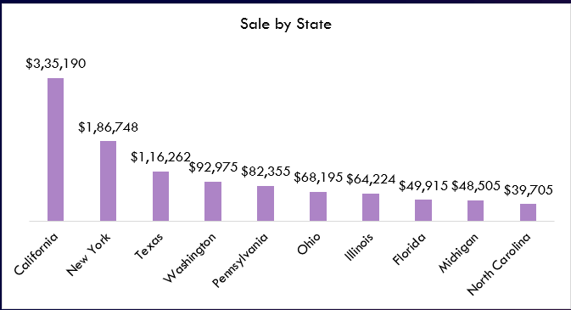
Sale by State: Regional Performance Snapshot
State-Wise Sales
Top Performing States
California, New York, and Texas emerge as top performers, showcasing significant contributions to overall sales.
California, New York, and Texas emerge as top performers, showcasing significant contributions to overall sales.

Slide 3
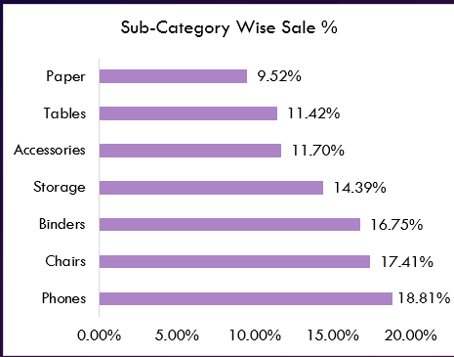
Sub-Category Wise Sale %: Deeper Product Performance
1. Furniture
2. Office Supplies
Furniture sub-category accounts for the largest percentage of overall sales, highlighting its strong market appeal.
Office supplies maintain a solid position in terms of sale percentage, indicating steady demand across the board.
3. Technology
Technology products contribute a significant portion to sales, reflecting the growing importance of digital tools and equipment.

Slide 4
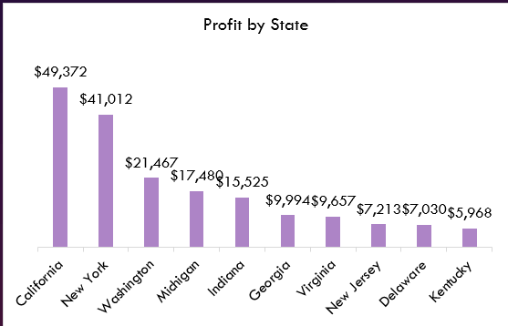
Profit by State: Identifying Profitability Hotspots
Profitability by State
The column chart provides a clear view of profit generated by each state, identifying both profitable and less profitable regions.
Profitable Regions
California and New York stand out as highly profitable states, contributing significantly to the company's bottom line.

Slide 5
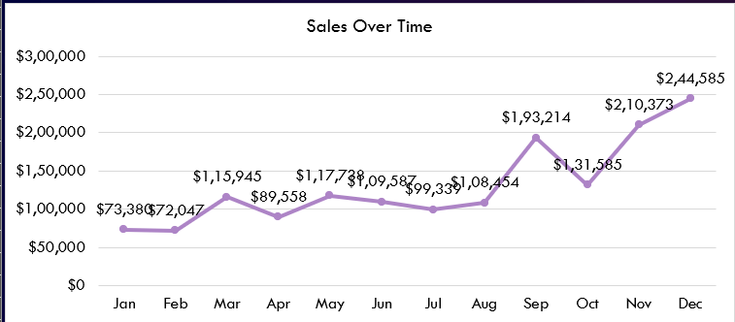
Sales Over Time: Tracking Growth and Trends
Sales have shown a consistent upward trend over time, indicating sustained growth and positive market momentum.
Seasonal fluctuations in sales are clearly visible, with peaks during the holiday season and dips during slower periods.
Analyzing these trends provides valuable insights for planning and adjusting marketing strategies to capitalize on peak seasons.

Slide 6
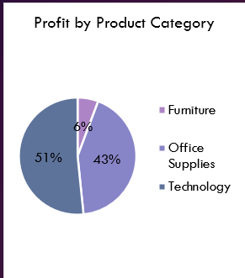
Profit by Product Category: Unveiling Key Profit Drivers
Technology
Top profit driver, contributing significantly to overall profitability.
51% of total Profit
Office Supplies
Substantial contribution to total profits.
Furniture
Less Profitable As compare to Technology & Office Supplies

Slide 7
Returns by Product Category: Identifying Potential Issues
Technology
Technology has the highest return rate, indicating potential issues with product quality, customer satisfaction, or delivery.
Office Supplies
Office supplies have a moderate return rate, suggesting a balance between customer satisfaction and occasional issues.
Furniture
Furniture products have the lowest return rate, indicating high customer satisfaction and a robust product quality.

Slide 8
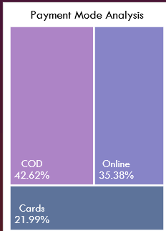
Payment Mode Analysis: Unveiling Customer Preferences
Cash
Still significant, highlighting traditional payment preferences in specific market segments.
Online
Growing in popularity, showcasing the convenience of digital payments.
Card
Customers gives last priority to card payments over COD & Online method.

Slide 9
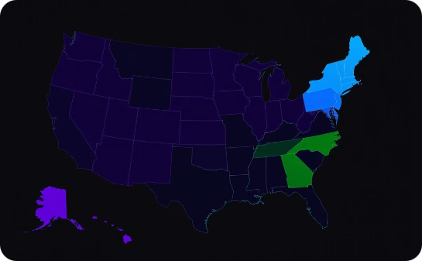
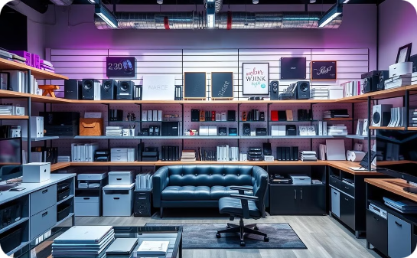
Conclusion and Key Takeaways
Regional Performance
Product Performance
Return Analysis
California, New York, and Texas are leading in sales and profits, requiring targeted marketing efforts to maintain momentum.
Technology and Office supplies are strong performers while Furniture
products are gaining traction, requiring continued investment
Technology has the highest return rate, requiring investigation and potential improvements to product quality or customer service.

Slide 10
Thank You
Thank you for your attention! We've explored key insights from our Super Store Sales Dashboard, providing a comprehensive overview of our performance. We will use this information to make data-driven decisions and continue to drive sales growth.

